Slide 1
Queue

Slide 2
Queue
Queue is a linear data structure that permits insertion of an element at one end and deletion of an element at the other end.
The end at which the deletion of an element take place is called front, and the end at which insertion of a new element can take place is called rear.
The deletion or insertion of elements can take place only at the
front and rear end of the list respectively
first element that gets added into the queue is the first one to get removed from the list. Hence, Queue is also referred to as First-In-First-Out (FIFO) list.

Slide 3
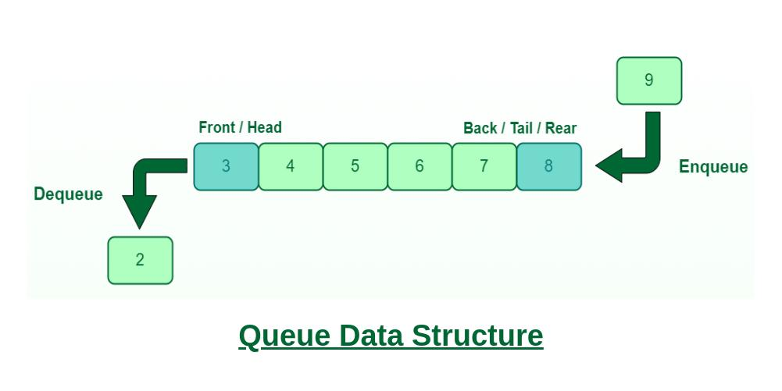

Slide 4
Queue
Consider a railway reservation booth, at which we have to get into the reservation queue. New customers got into the queue from the rear end, whereas the customers who get their seats reserved leave the queue from the front end.
It means the customers are serviced in the order in which they arrive the service center (i.e. first come first serve type of service)

Slide 5
Operations on Queue
Enqueue − add/ store an item to the queue.insertion will be done at rear
dequeue − remove an item from the queue.deletion will be done at front

Slide 6
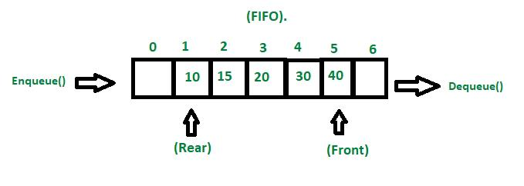
Queue

Slide 7
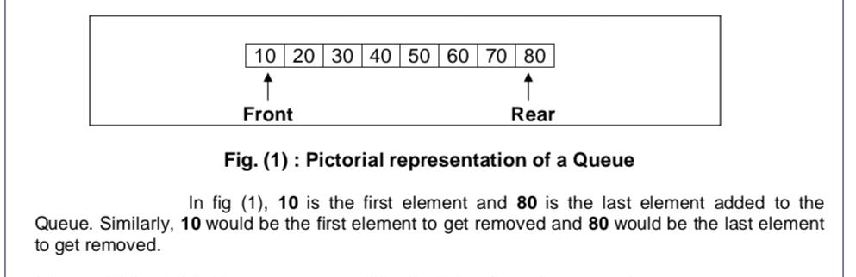
Queue

Slide 8
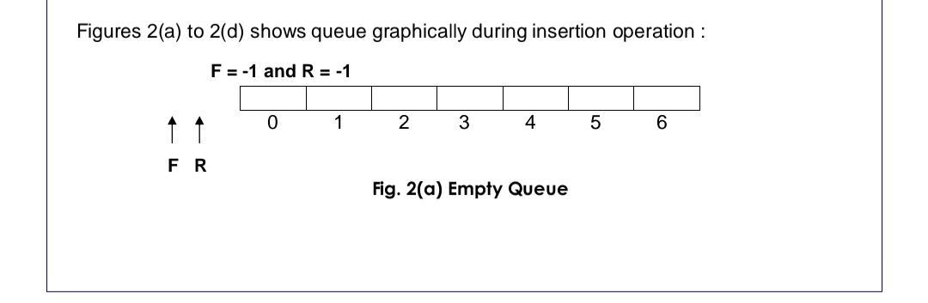
Queue

Slide 9
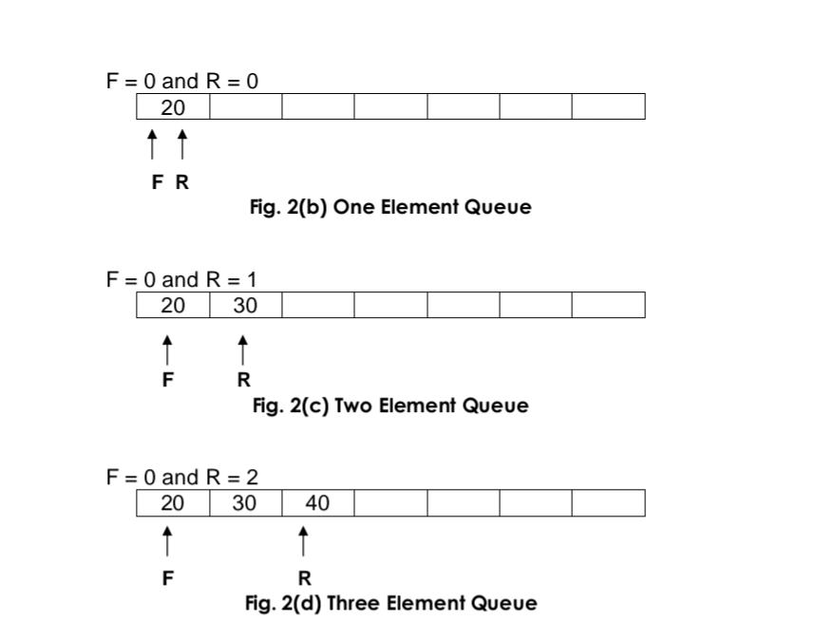
Queue

Slide 10
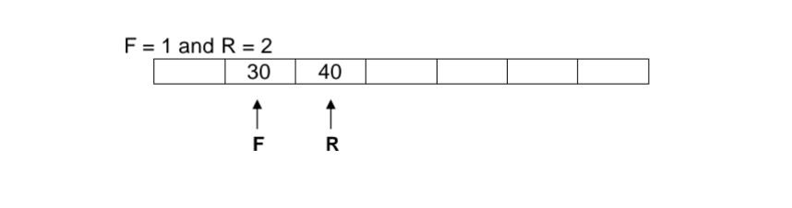
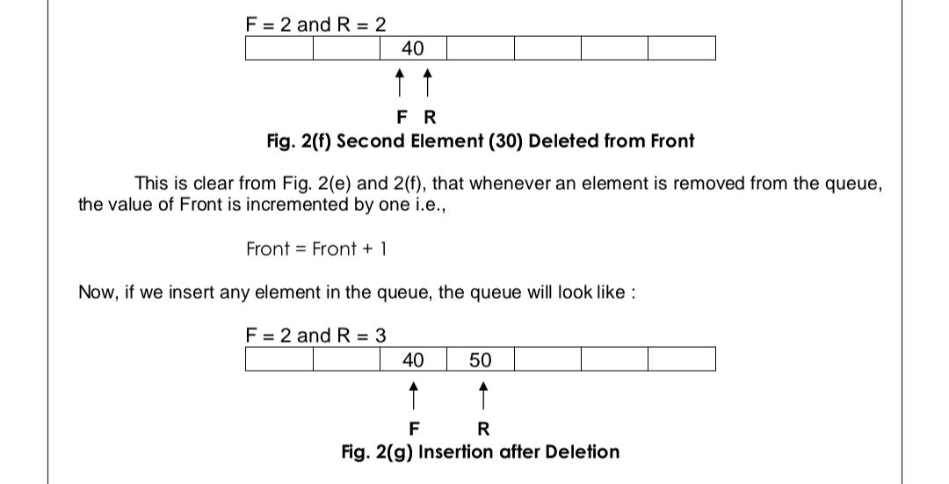
Queue

Slide 11
Queue Implementation using Array
Algorithm for Enqueue
1)Start
2)Declare item
3) Check if rear =size-1, then go to step4 else go to step5
4) Print Queue overflow and go to step 10
5) Read the element to be inserted as item
6) Check if front=-1, then go to step7 else go to step8
7) Assign front as front+1
8) Set rear as rear+1
9) Assign queue[rear] as item
10) stop

Slide 12
Queue Implementation using Array
void enqueue() {
Int item;
If(rear=size-1) {
Printf (“Queue overflow. Insertion cannot be done”) ;}
Else{
Printf (“Enter element to be inserted “) ;
Scanf(“%d”, &item) ;
If(front==-1) {
front=front+1;}
rear=rear+1;
Queue[rear]=item;}}

Slide 13
Queue Implementation using Array
Algorithm for Dequeue
1) start
2) Declare item
3) Check if front=-1 Or front>rear, then go to step4 else go to step5
4) Print Queue underflow go to step8
5) Set item=queue[front]
6) Assign front as front+1
7) print the deleted item as item
8) Stop

Slide 14
Queue Implementation using Array
Void Dequeue () {
Int item;
If(front==-1||front>rear) {
Printf (“queue underflow. Deletion cannot be done”) }
else {
Item=queue [front];
front=front+1;
Printf (“deleted item is%d”, item) ;}}

Slide 15
Queue Implementation using linked list
Enqueue
1)start
2) Declare a structure pointer new
3) Allocate memory to new
4) Read the element to be inserted as item
5) Set new->data=item
6) set new->next =NULL
7) check if rear=NULL then go to step8 else go to step9
8)Set Front=rear=new
9) set rear->next=new
10) Set rear=new
11) stop

Slide 16
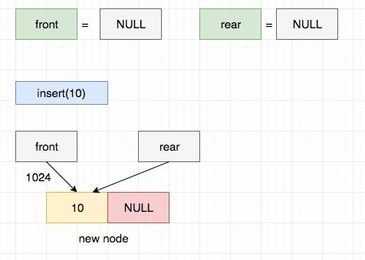
Queue Implementation using linked list

Slide 17
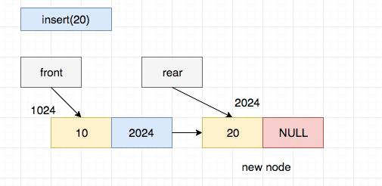
Queue Implementation using linked list

Slide 18
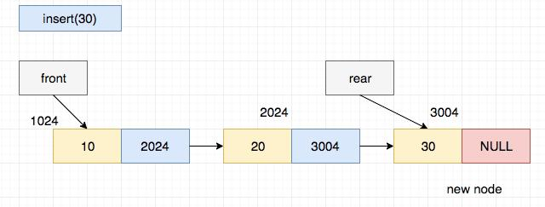
Queue Implementation using linked list

Slide 19
Queue Implementation using linked list
Dequeue
Start
Declare a structure pointer temp
Check if front=NULL, then print Queue underflow then go to step 10 else step4
4) Assign Temp as front
5) Check if front->next=NULL, then repeat step6-7 else go to step7 6) Set front=rear=NULL 7) Return temp->data
8) Set front=temp->next
9) Delete temp
10) stop

Slide 20
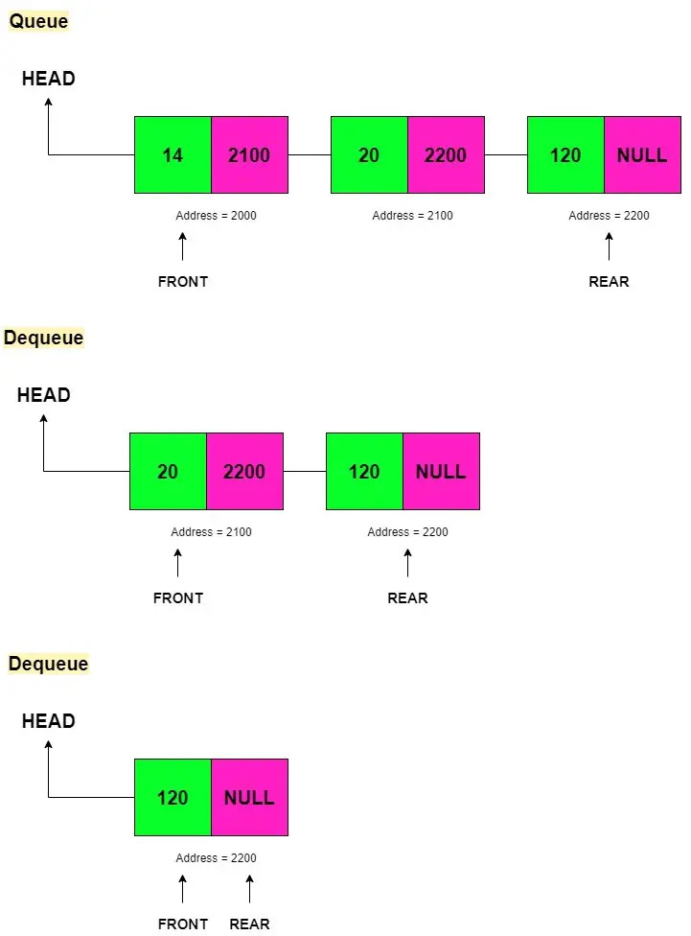
Queue Implementation using linked list

